Slide 1
Chicago

Slide 2
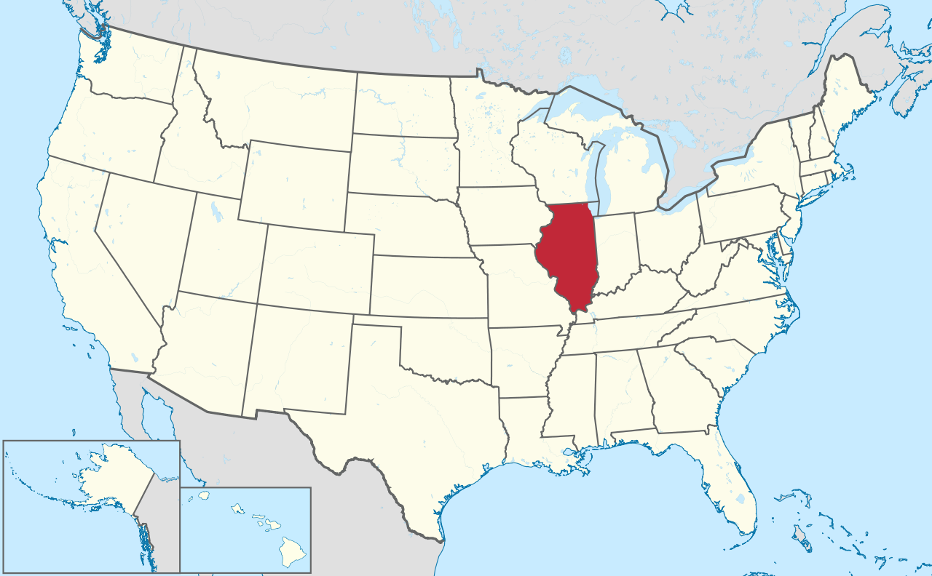

Slide 3
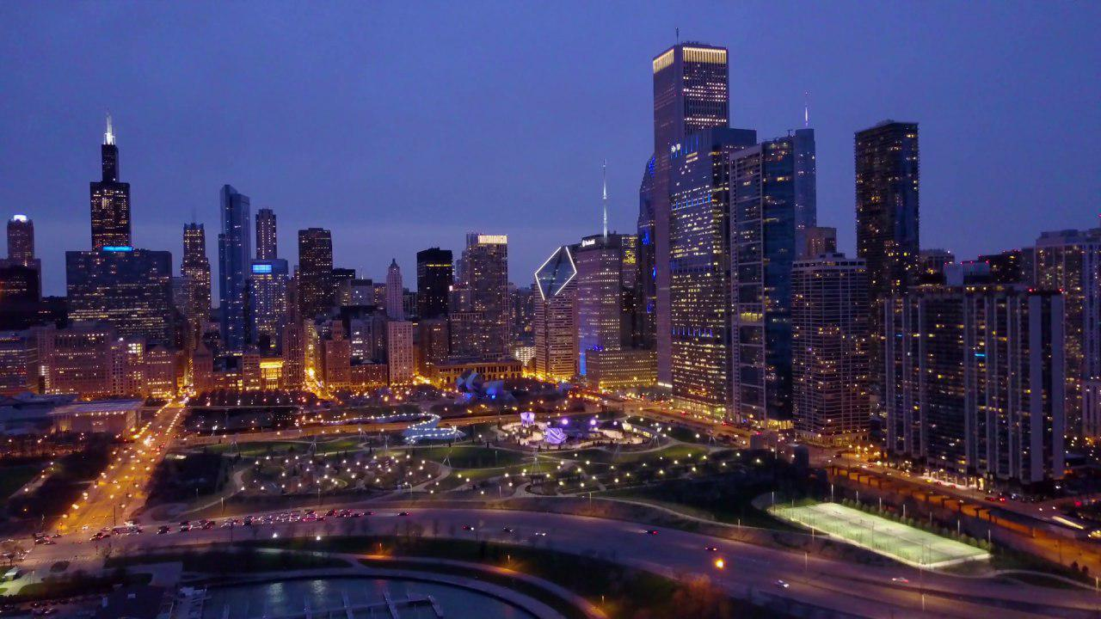
Chicago
The main highlight of the state of Illinois, a sophisticated city that many consider the US cultural center.

Slide 4
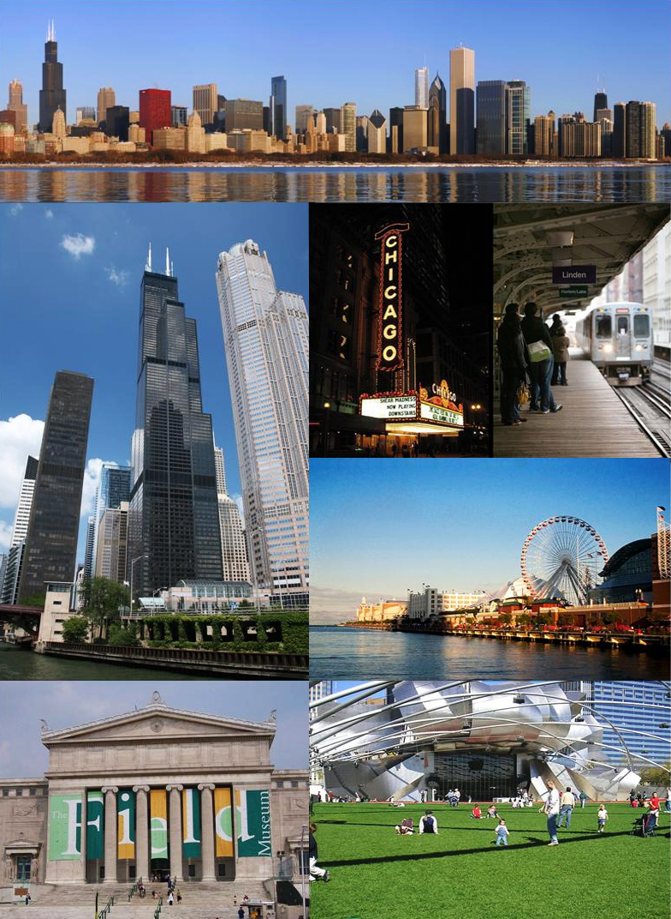
Chicago has it all: Renowned museums, stunning architecture, Michelin-starred restaurants.

Slide 5
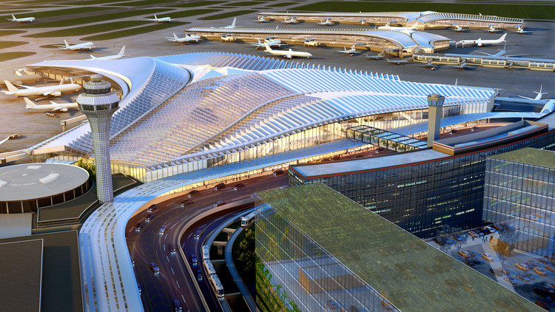
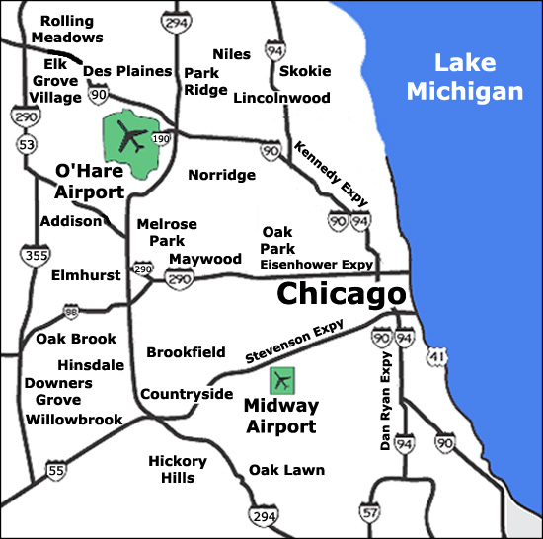
Chicago Airport
How to get to Chicago?
You can get to Chicago at two airports being the most famous the O’Hare Airport.
A flight from São Paulo to Chicago costs on average R$ 6.000,00 - depending on the season.

Slide 6
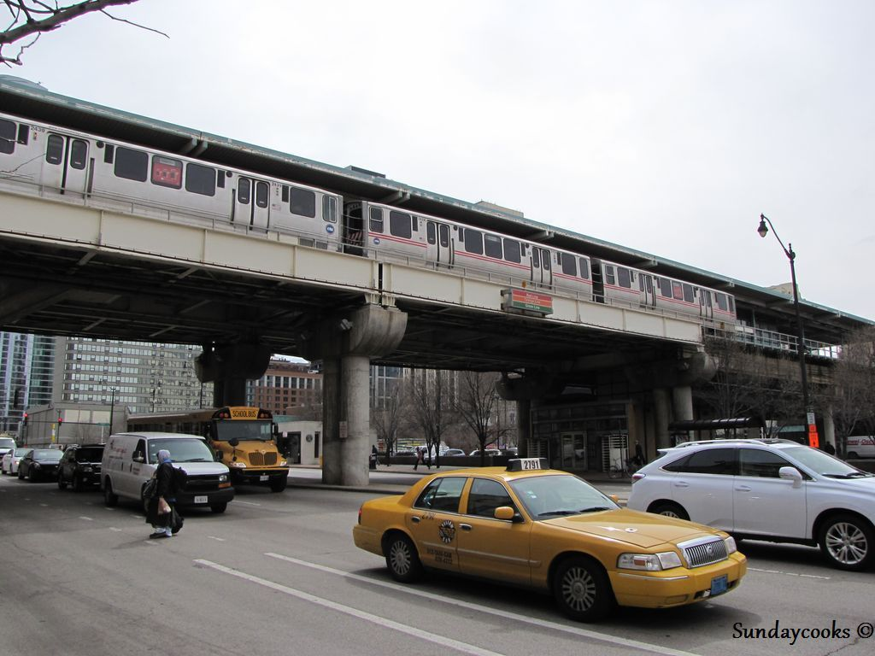
Chicago Transports
Getting from the airport to downtown Chicago is no secret. You can use the Metro, Shuttle, Taxi or even Limousines.

Slide 7
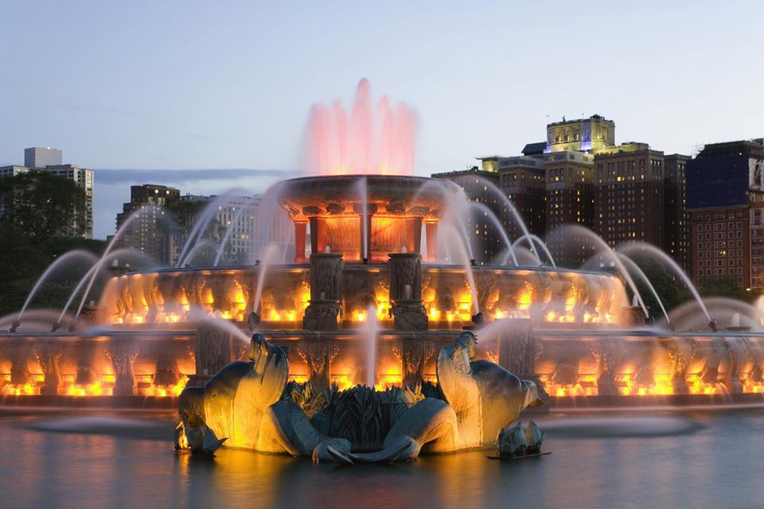
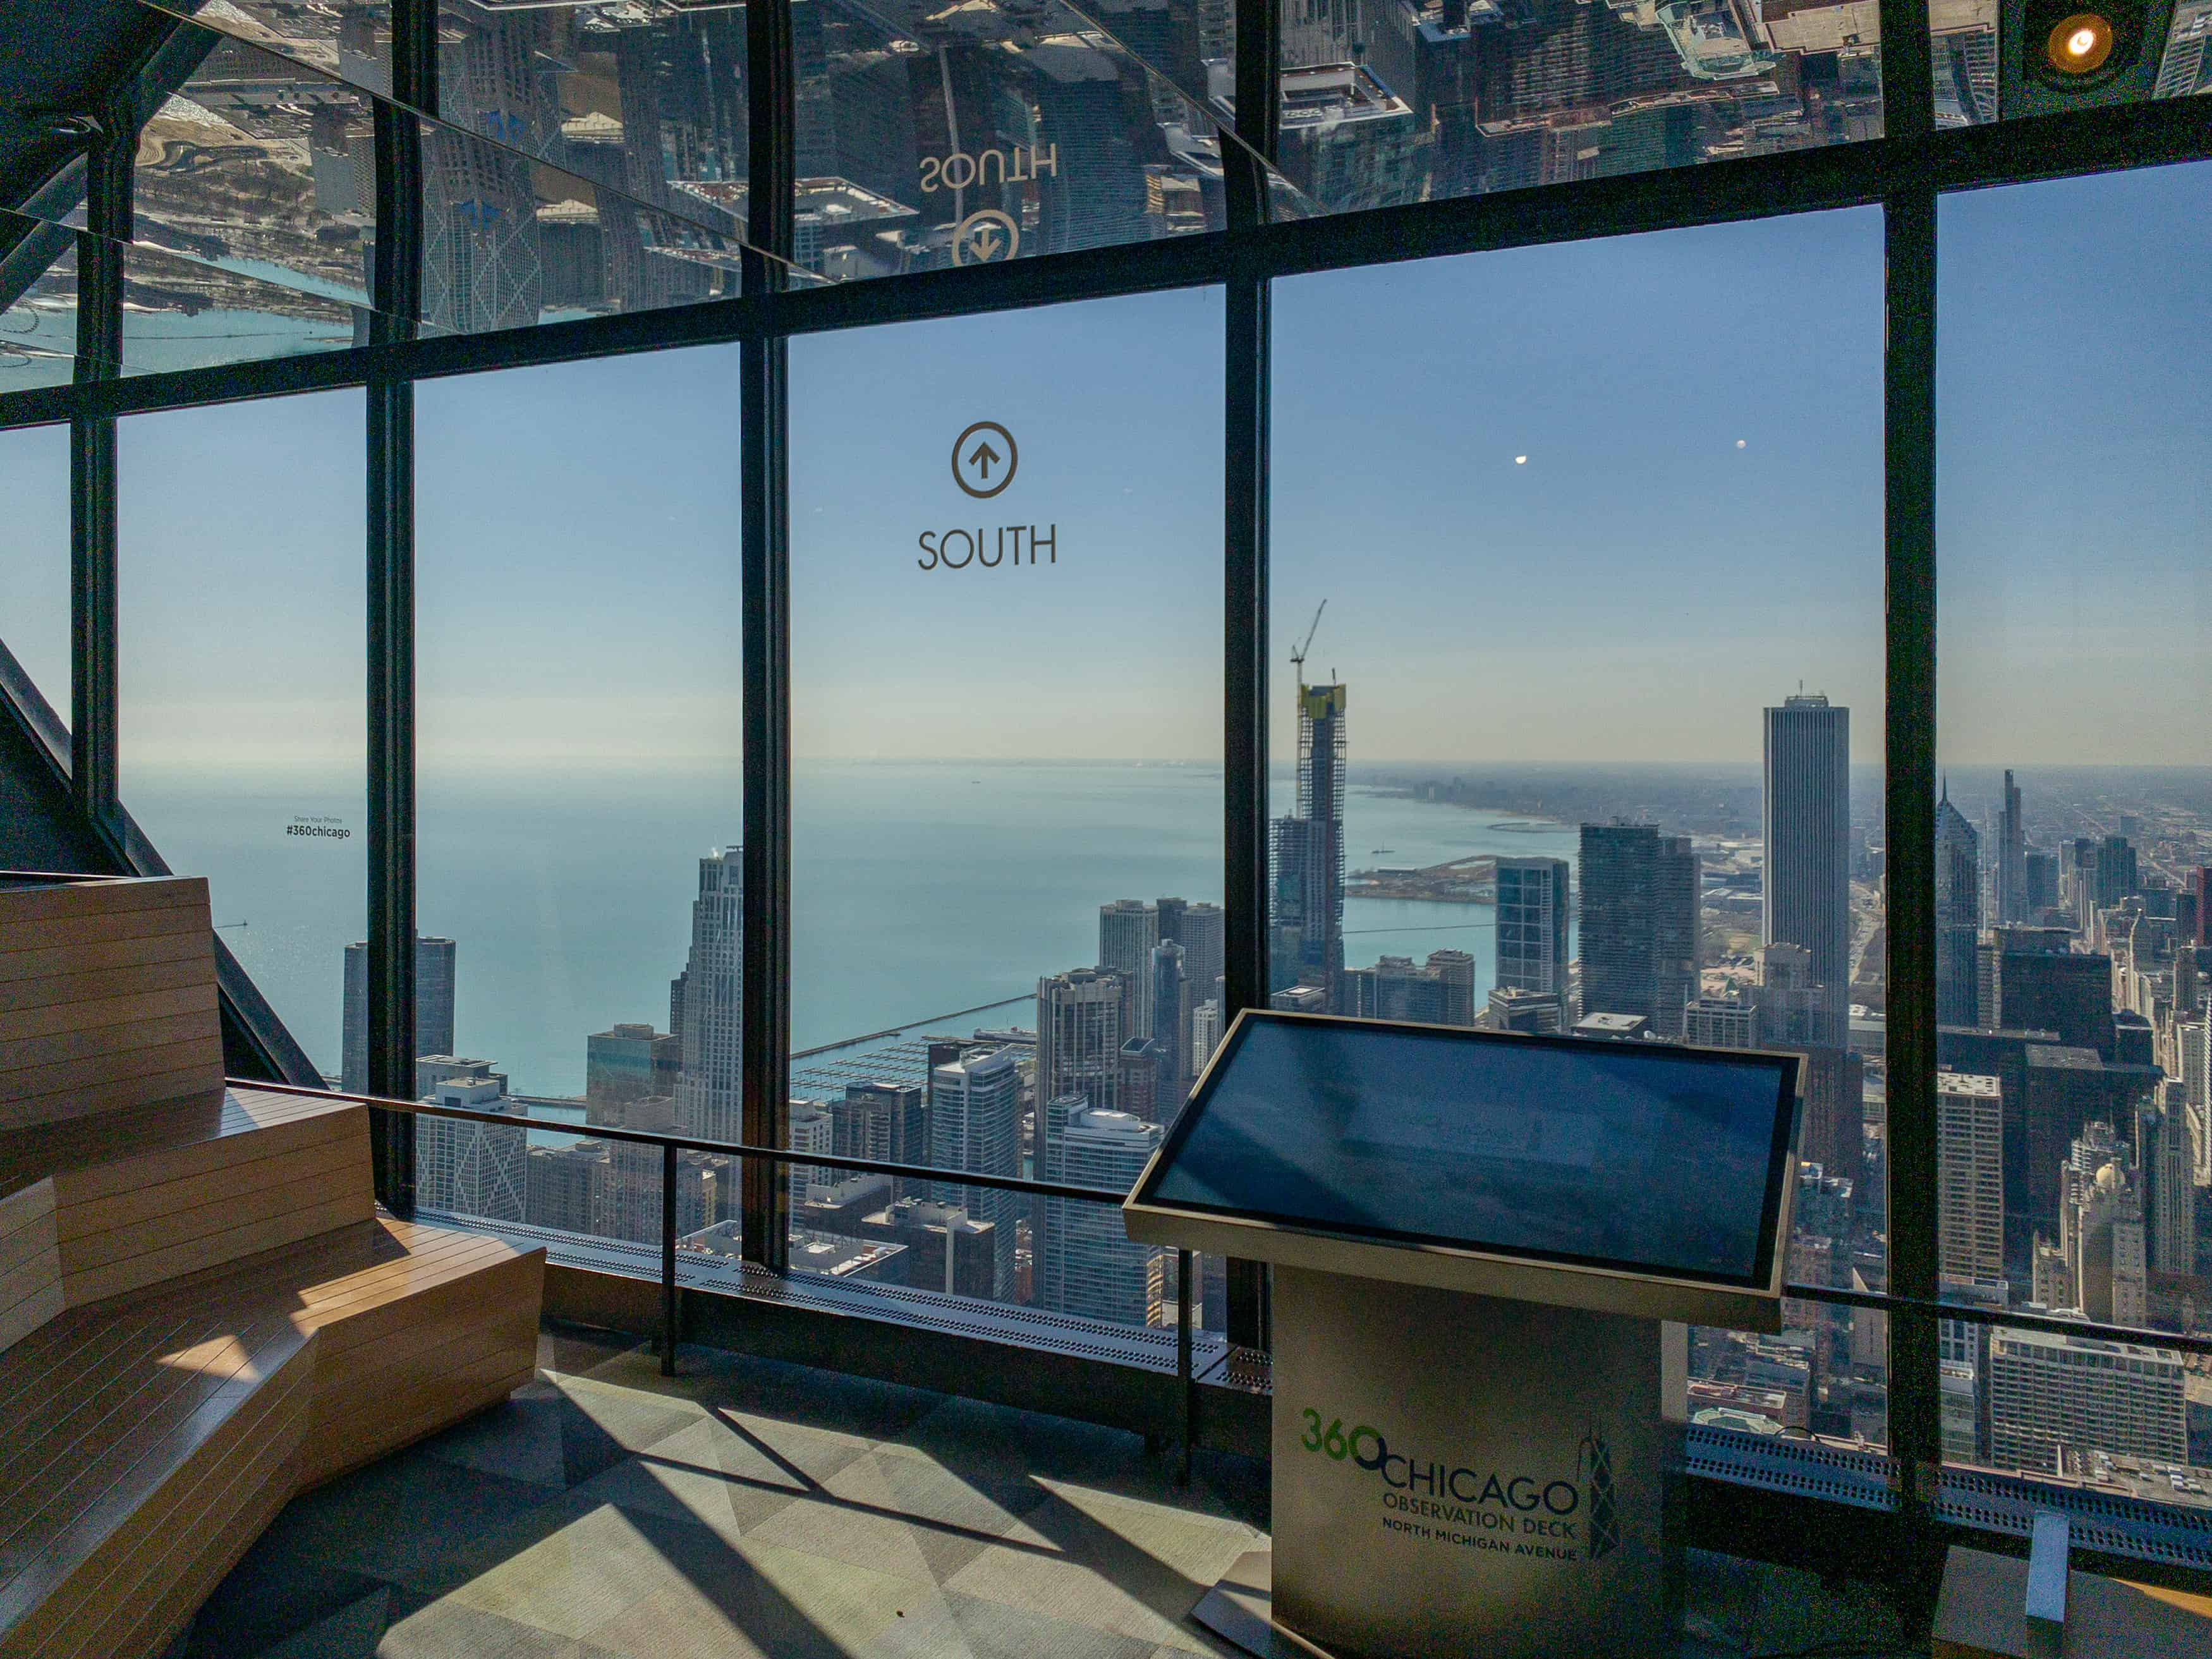
Turistic Spots - Chicago boasts a large number of tourist attractions, let's see the main ones
Get Your Thrills on the 360 Chicago Observation Deck
Watch the Water Show at Buckingham Fountain
.
Content Here
You can simply impress your audience and add a unique zing and appeal to your Reports.
Watch the Water Show at Buckingham Fountain

Slide 8
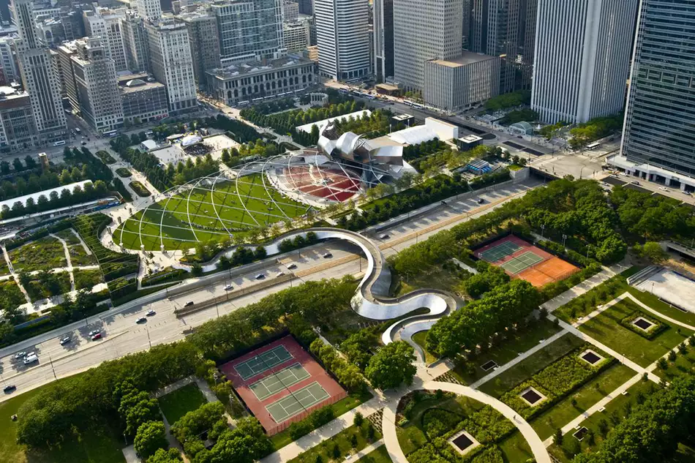
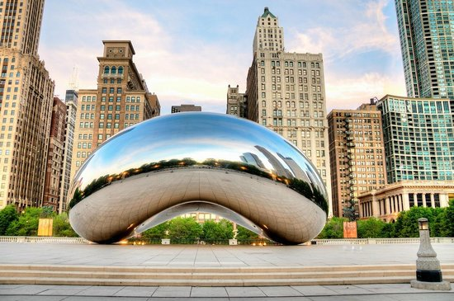
Stroll Millennium Park - The Bean. The Bean (a sculpture officially known as Cloud Gate) is quickly on its way to becoming Chicago's most recognizable icon:

Slide 9
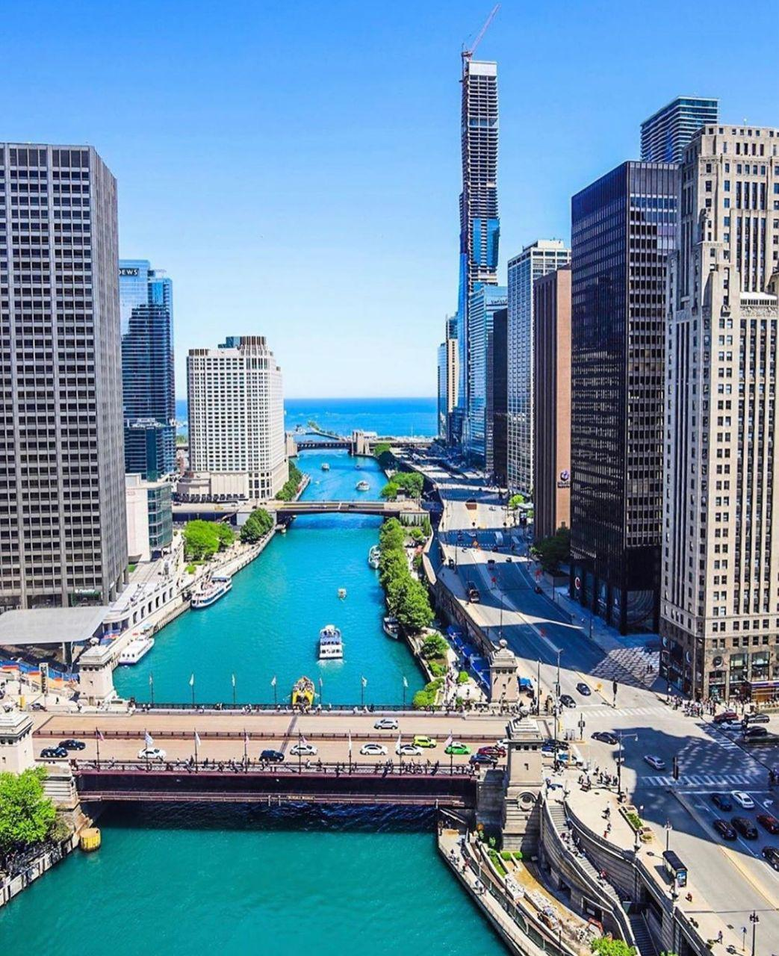
CHICAGO RIVER
Chicago River, navigable stream that originally flowed into Lake Michigan after being formed by the north and south branches about 1 mile (1.6 km) west of the lake, in Chicago, northeastern Illinois, U.S. The Chicago River system flows 156 miles (251 km) from Park City (north) to Lockport (south); some 45 bridges span the river.

Slide 10
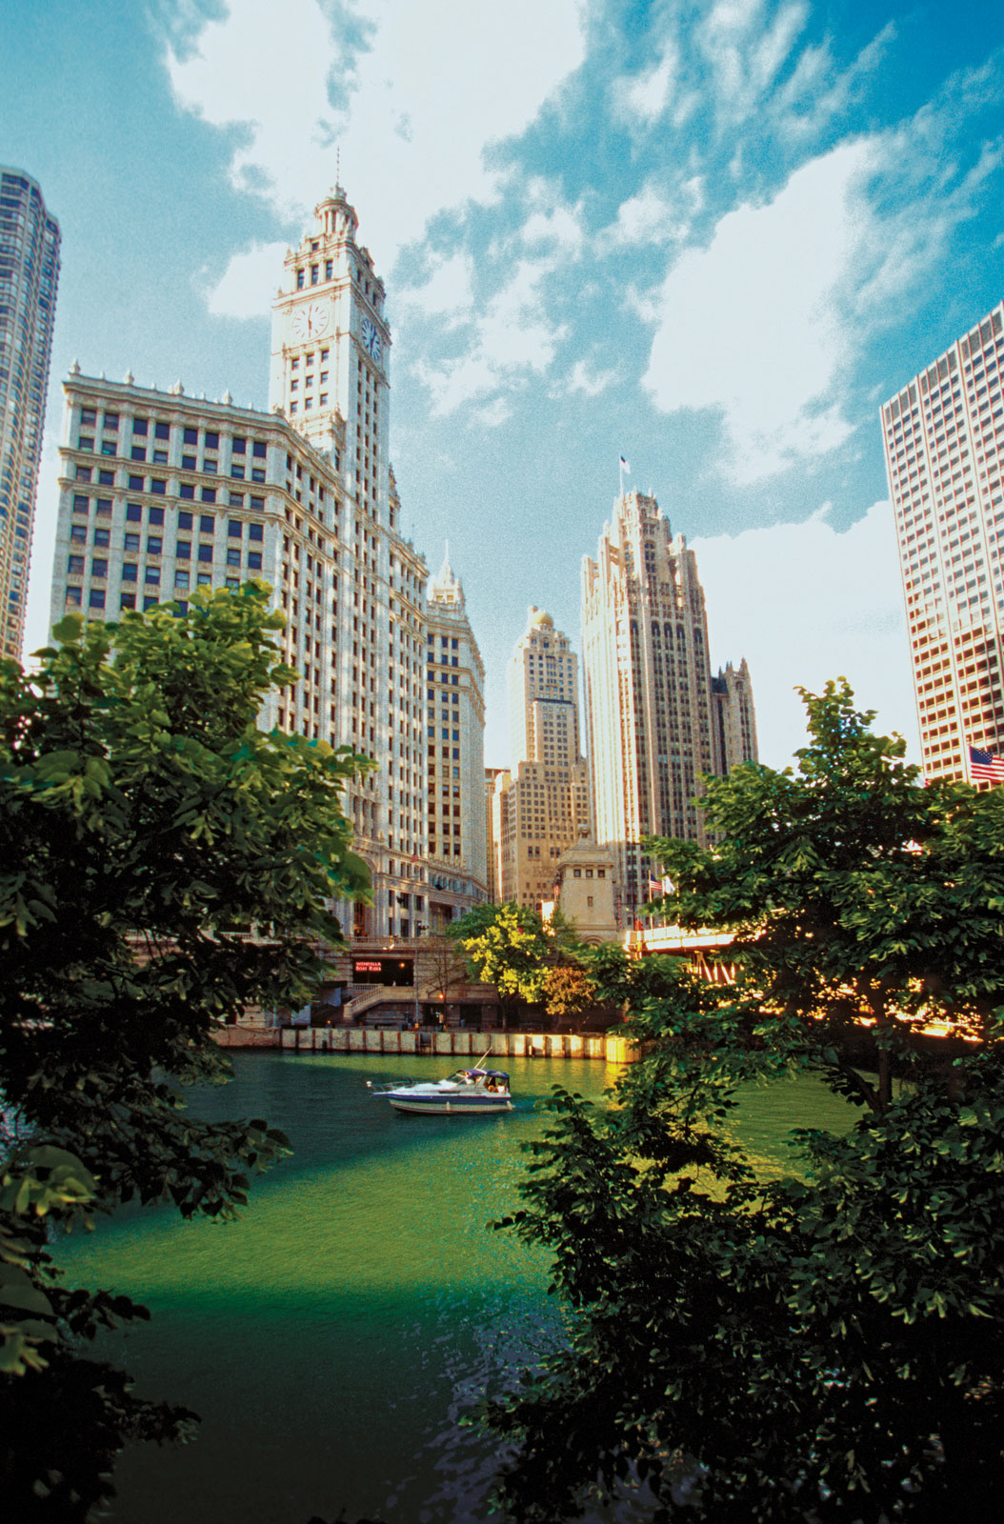
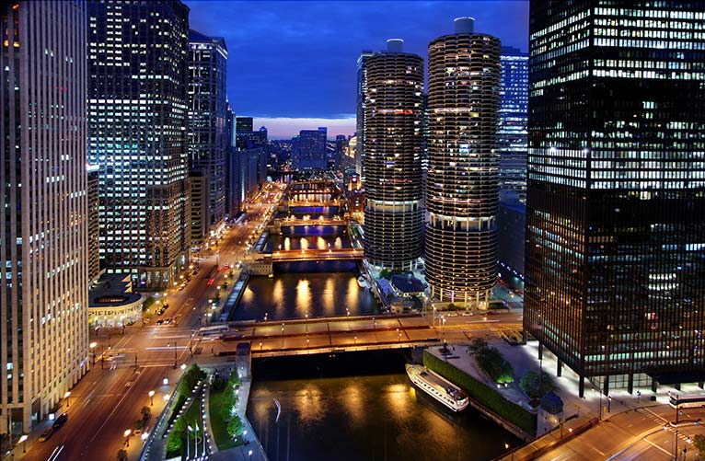
Chicago River

Slide 11
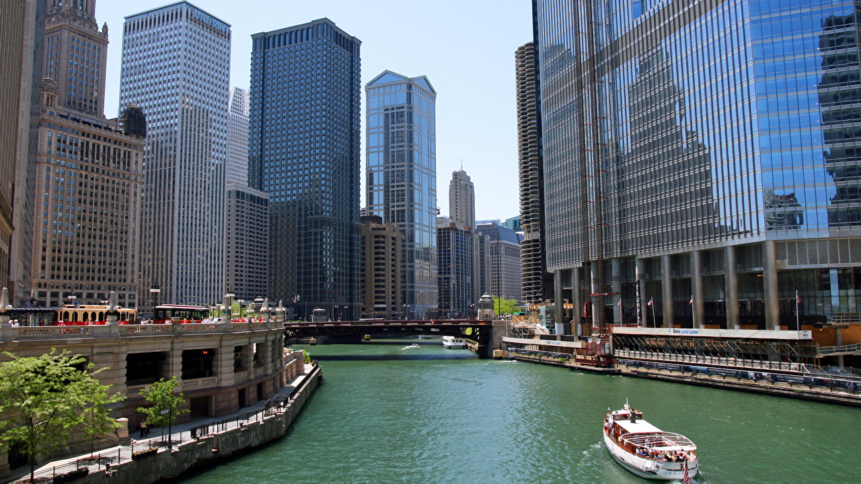

Slide 12
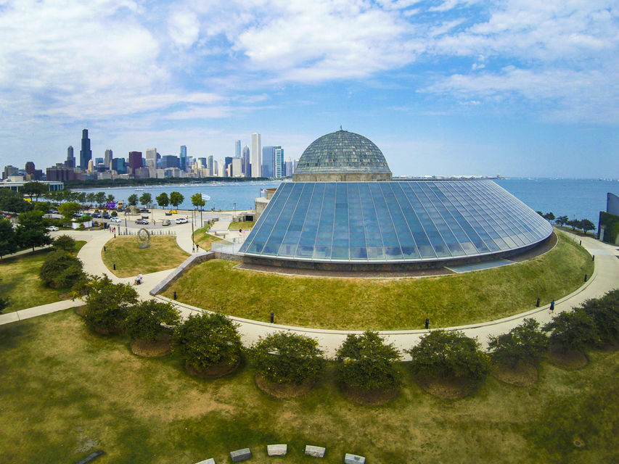
Adler Planetarium: Learn About the Planets
First when built in 1930, you'll learn about the Universe through displays, events, and shows.

Slide 13
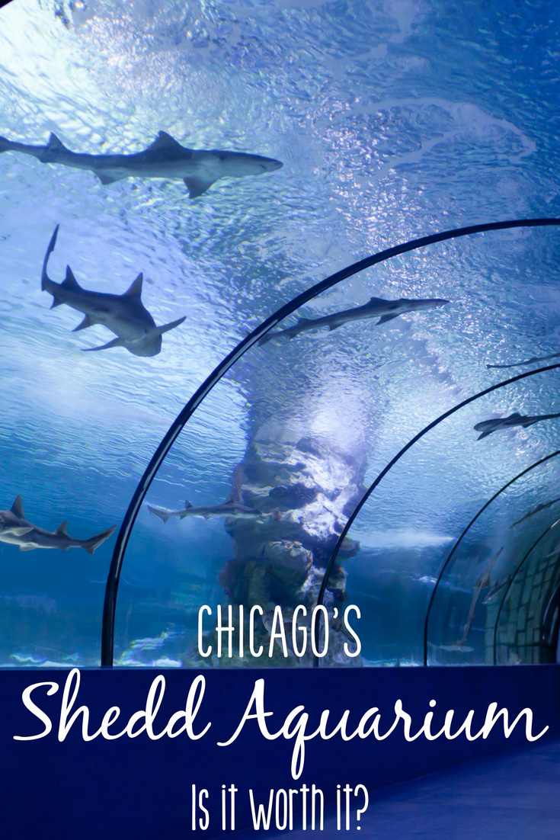
Sea Life Aquarium
With almost two million visitors a year, the Shedd Aquarium easily qualifies as one of Chicago's most popular attractions. And rightly so—it's one of the premier aquariums in the country. A word to the wise: Get there early, or you may be greeted with a long line snaking out the door and all the way down the aquarium's steps. Shedd Aquarium is part of Chicago's Museum Campus

Slide 14
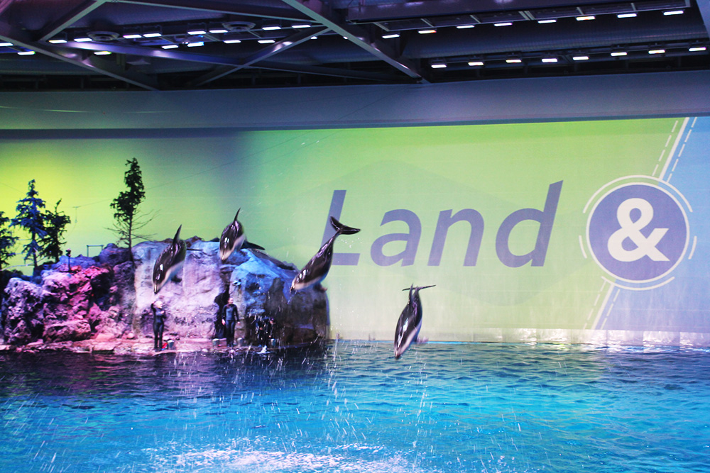
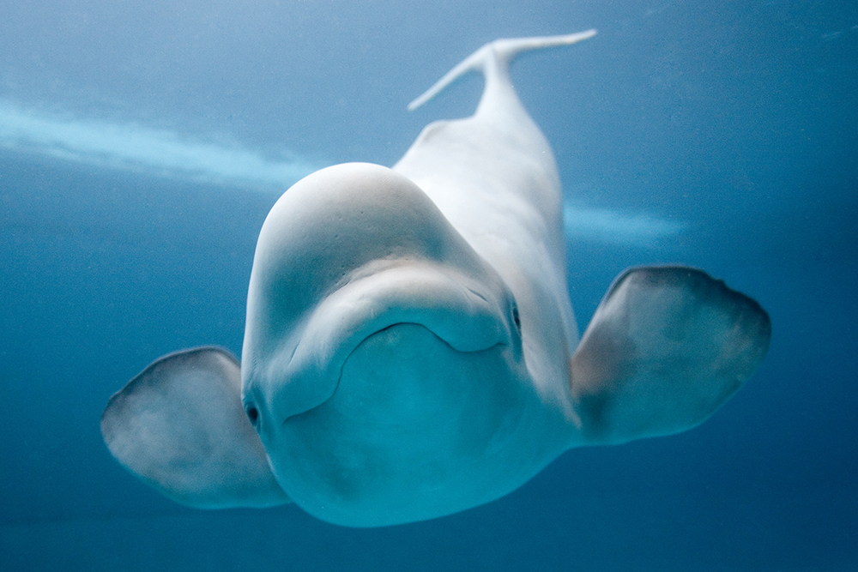
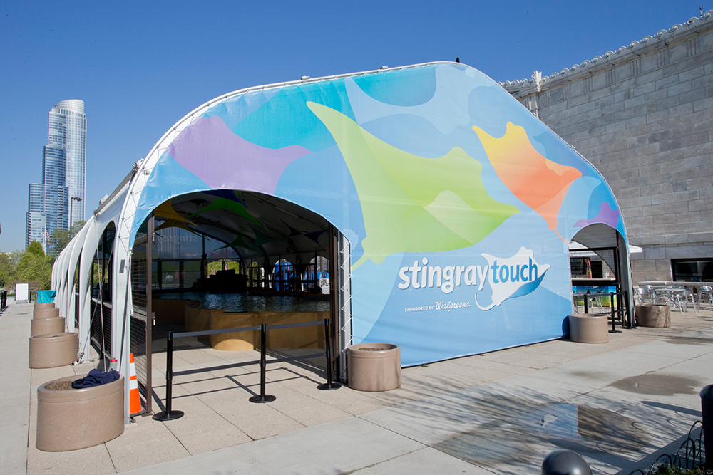
Shedd Aquarium
“One World”
dolphins, penguins and sea lions;
4D cinema showing sea life.

Slide 15
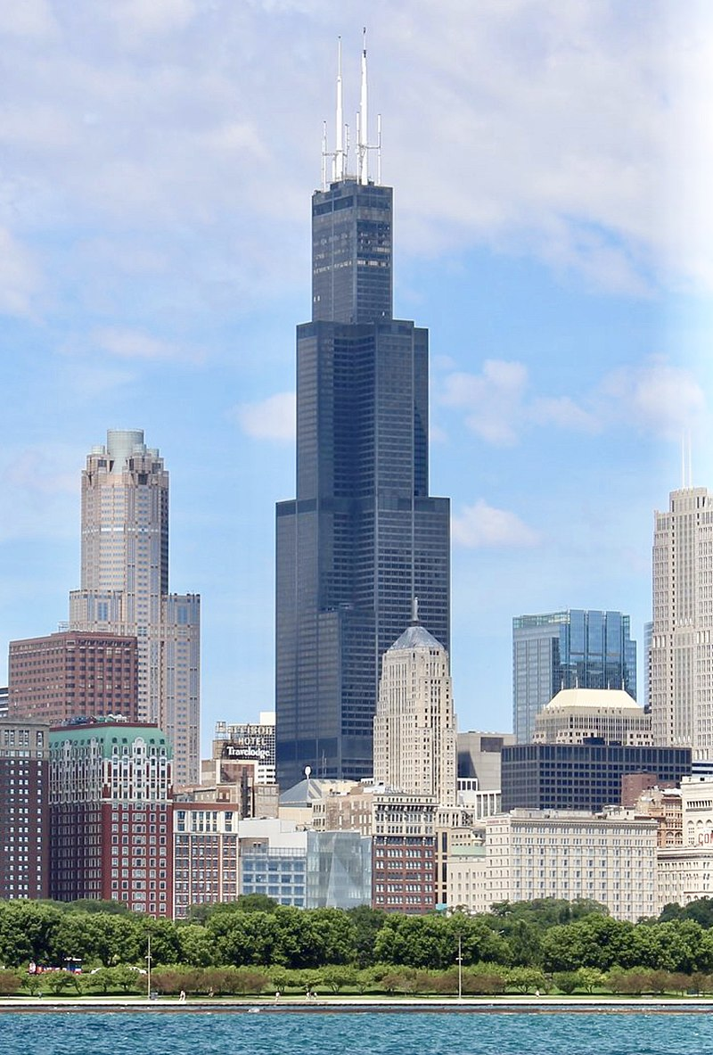
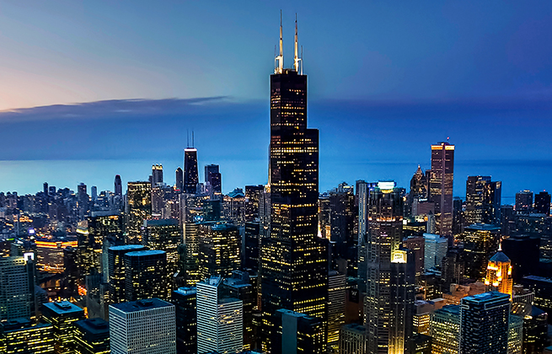
Willis Tower - Completed in 1974,
was the tallest building in the world for nearly 25 years.

Slide 16
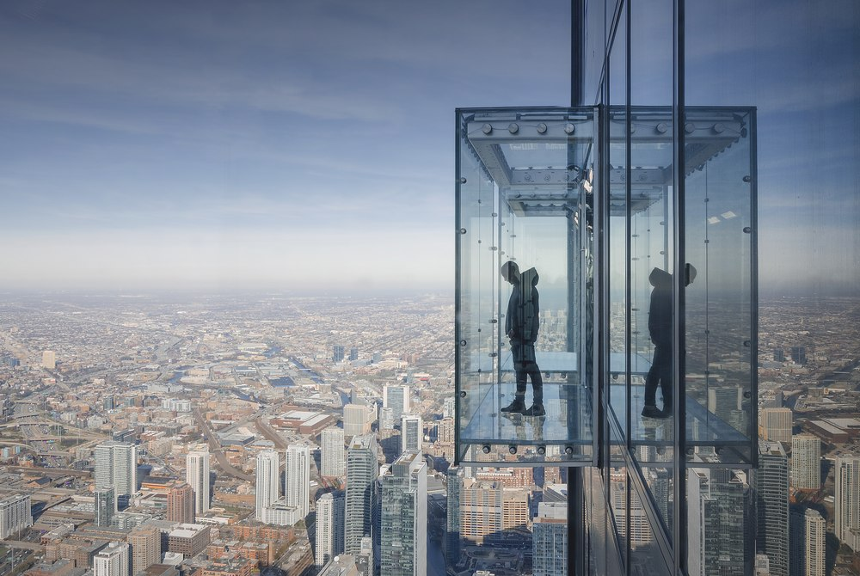
Willis Tower
Skydeck
From the top of Willis Tower is possible see four american states, they are Indiana, Illinois, Michigan e Wisconsin

Slide 17
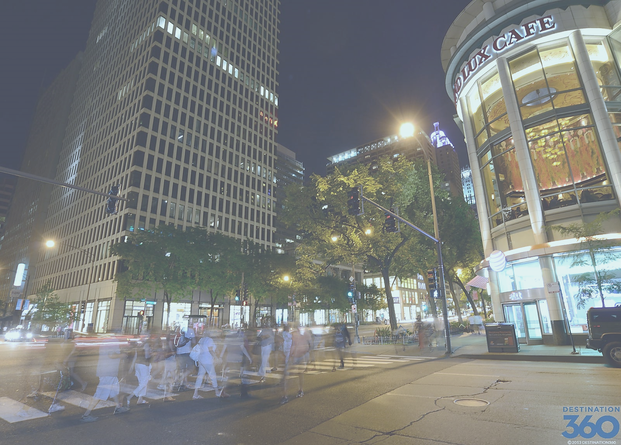
Magnificent Mile

Slide 18
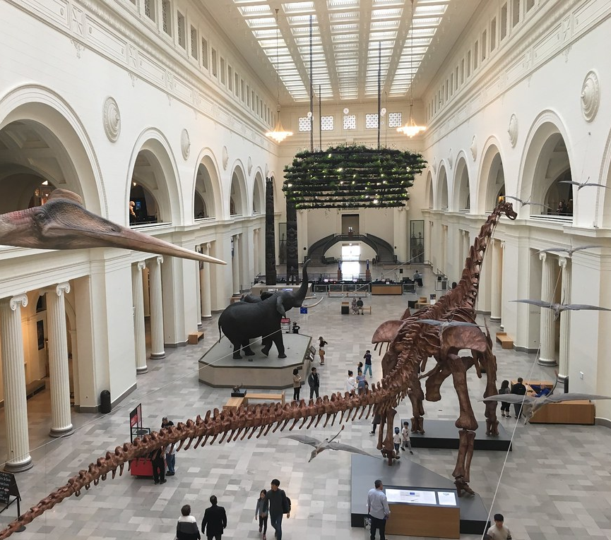
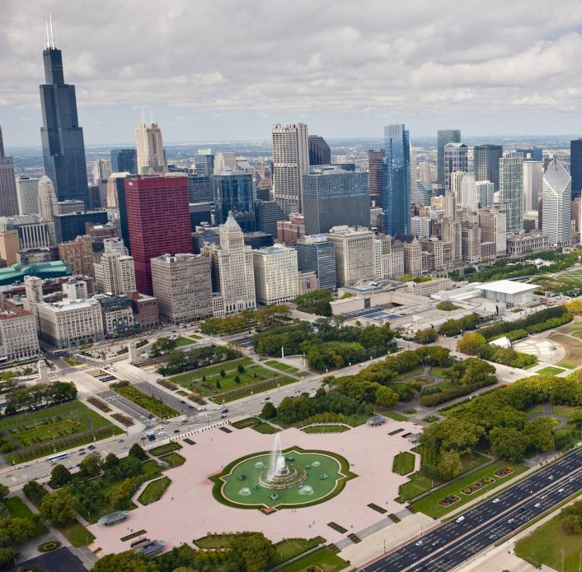
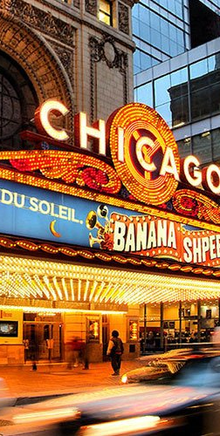
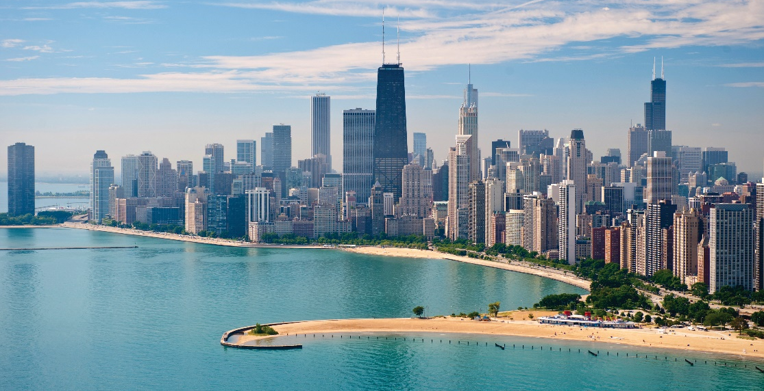
Touristic Spot
6 Beaches
19 Museums
20 Parks
20 Cinema Theater

Slide 19
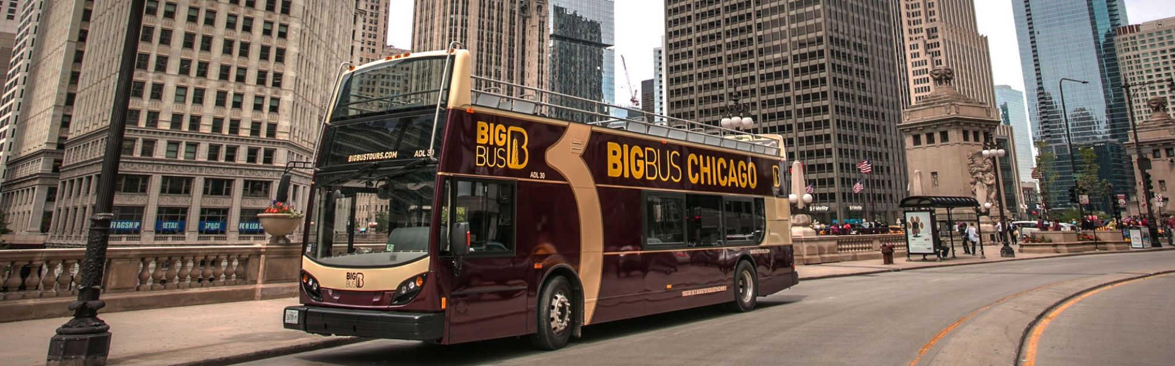
explanatory
explicativo
YOU COULD TAKE THE BIG BUS
This tours has an explanatory guide in English that you can listen with earphones.

Slide 20
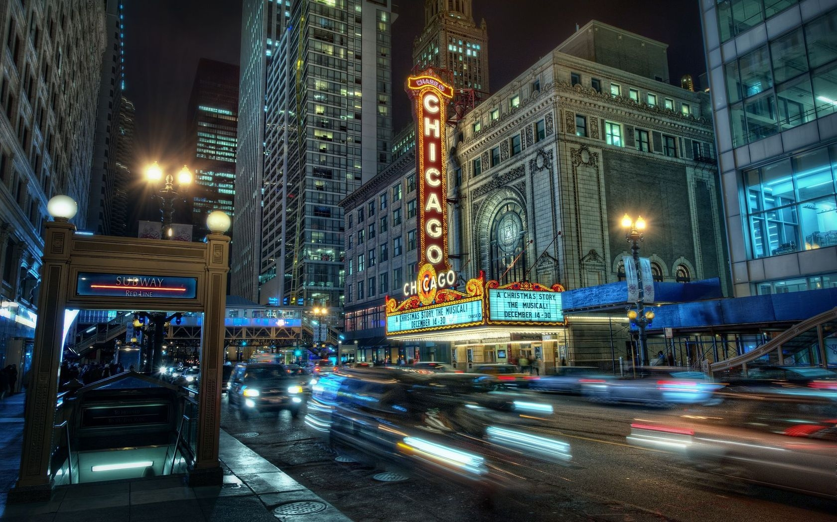
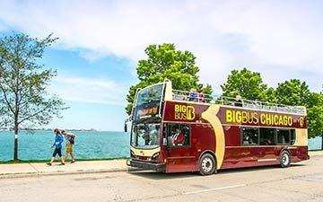
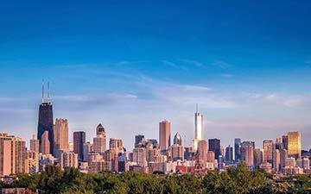
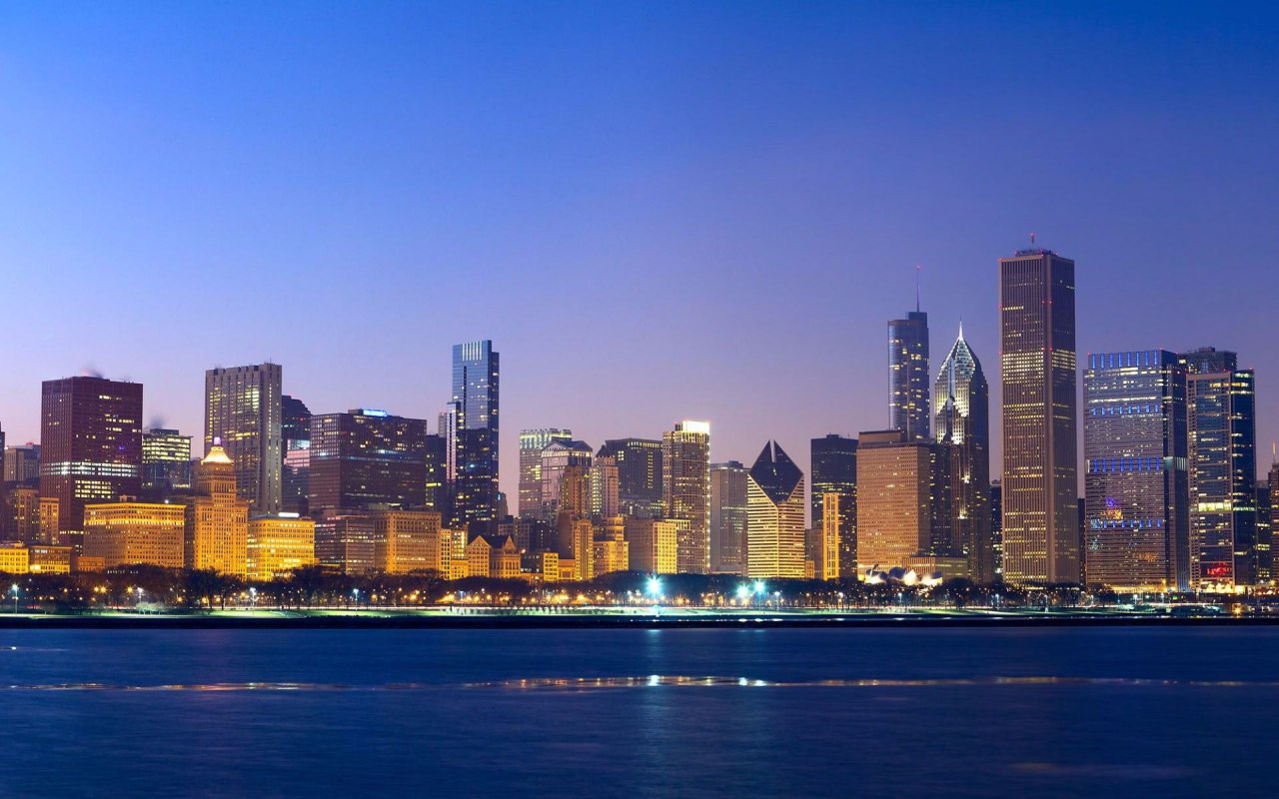
YOU CAN CHOOSE FOR:
Classic Ticket
Premium Ticket
Night Tour
US $ 41.40
US $ 50.40
US $ 29.00
1 Day hop on, hop off
2 Day hop on, hop off
Live Guides
Chicago Architecture Center
See all the top landmarks

Slide 21
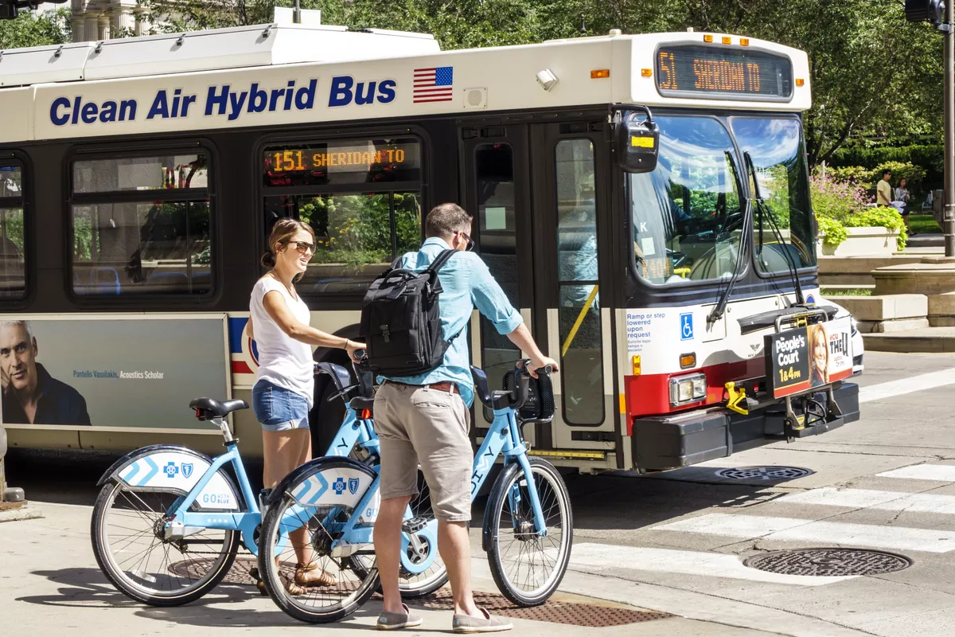

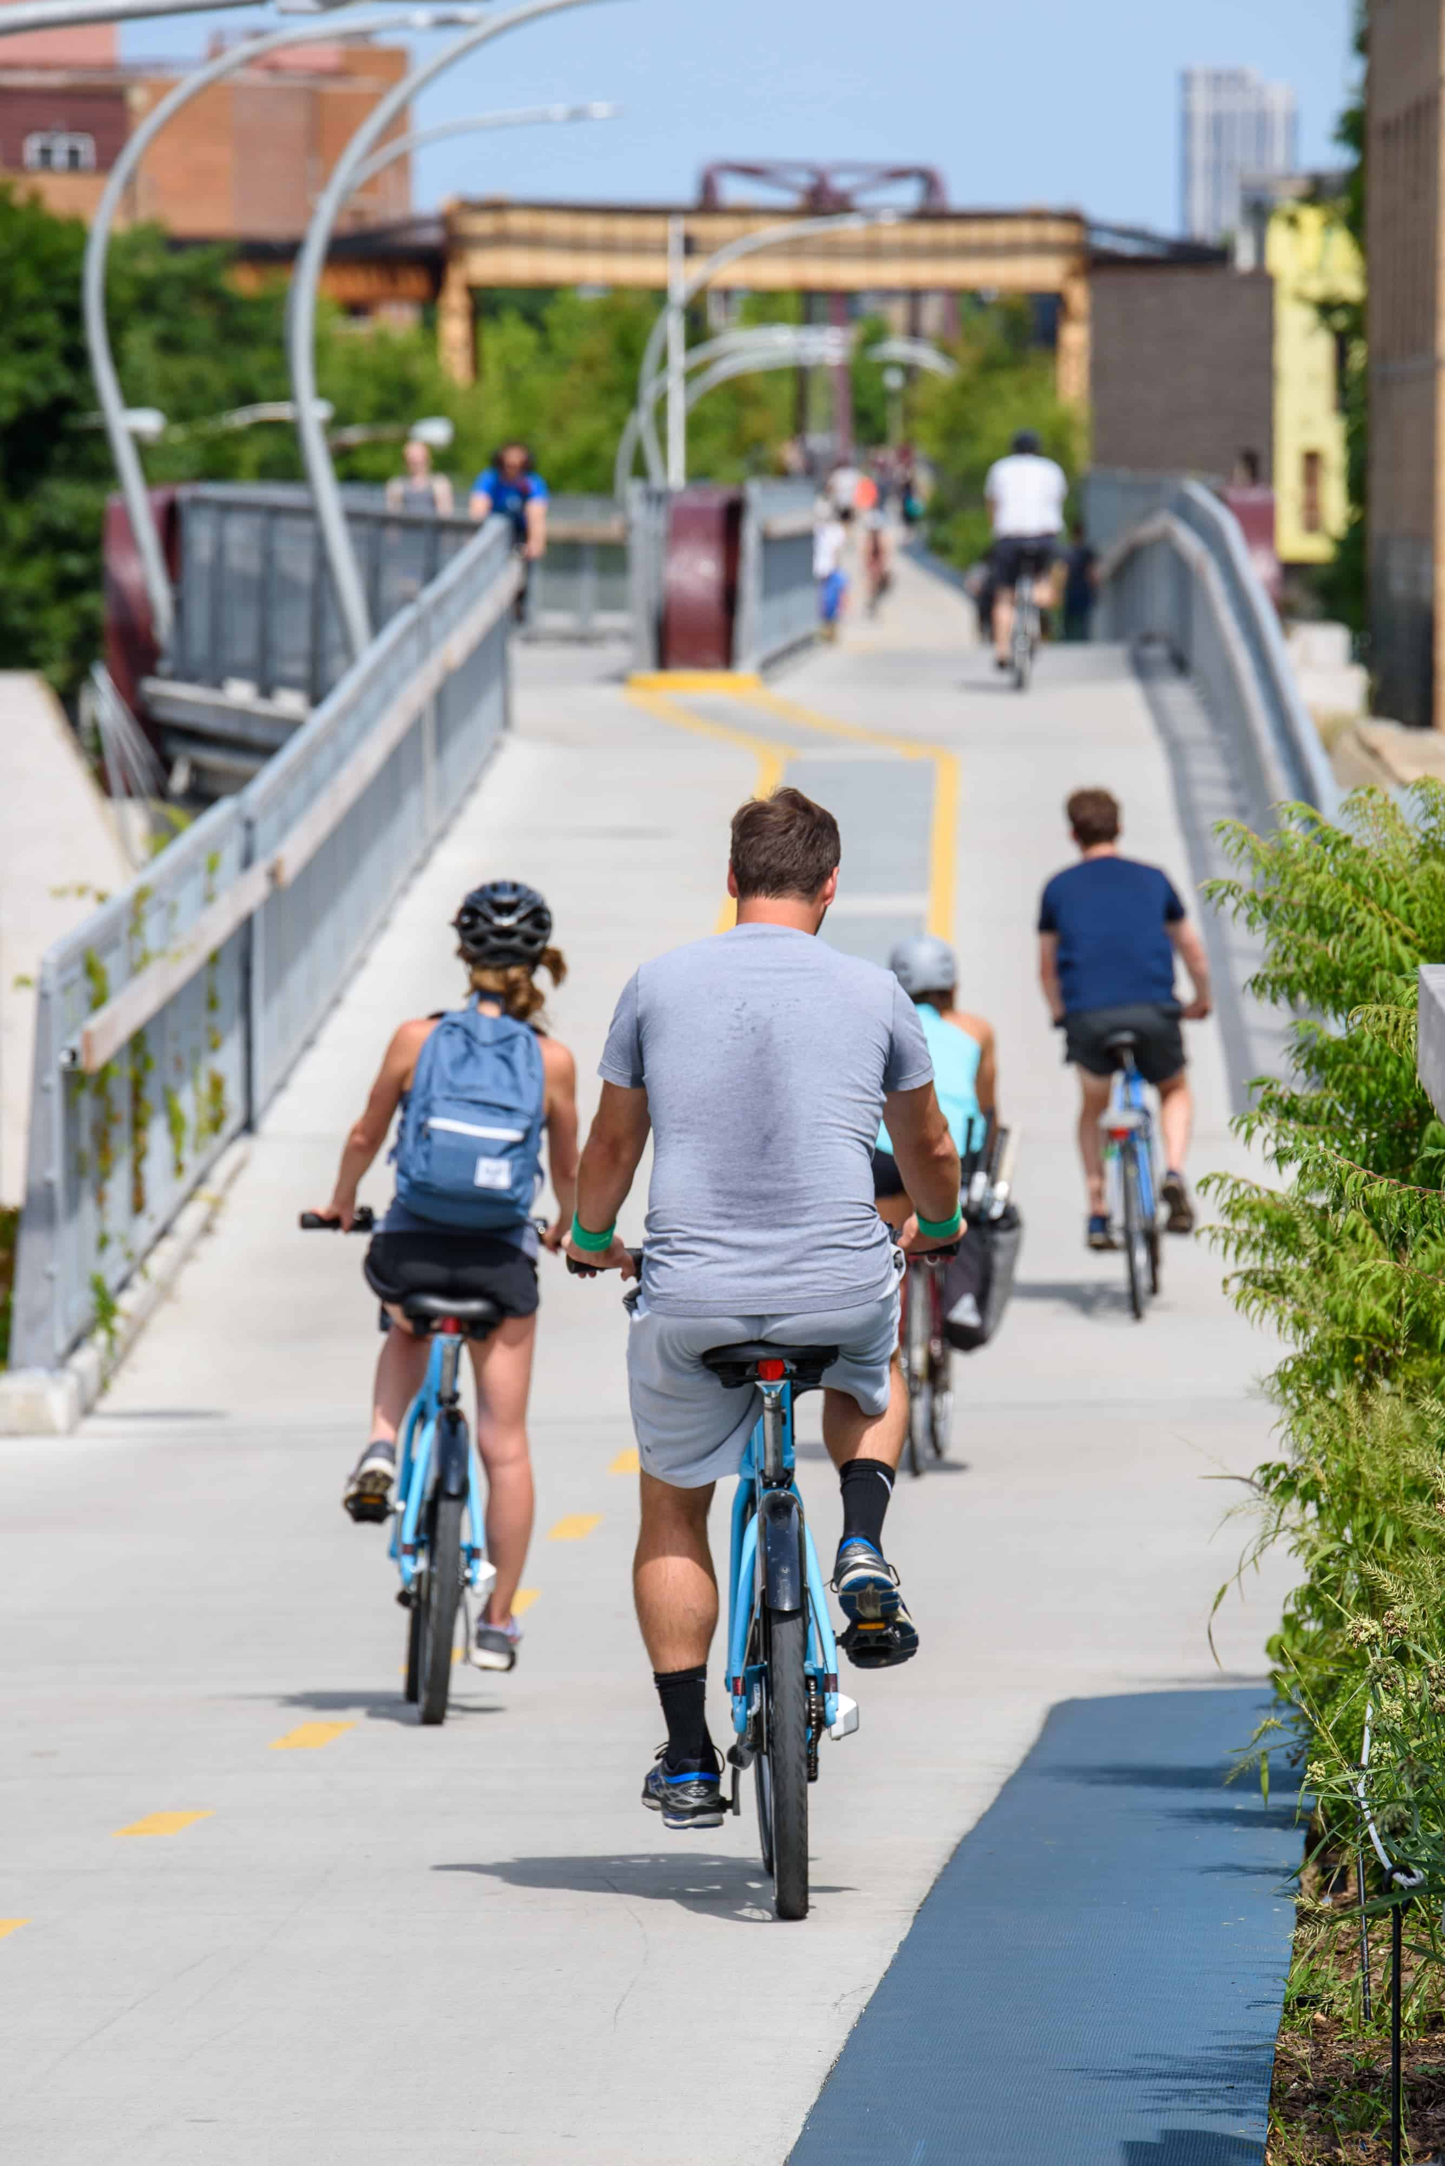
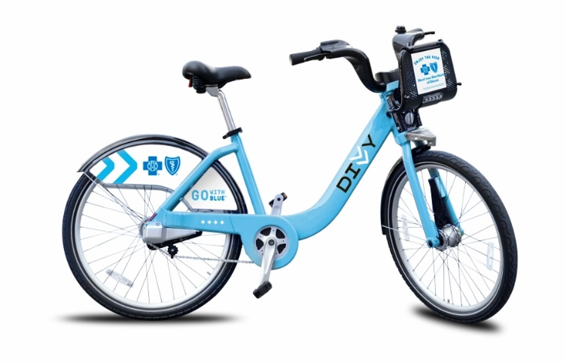
Ciclism
In Chicago

Slide 22
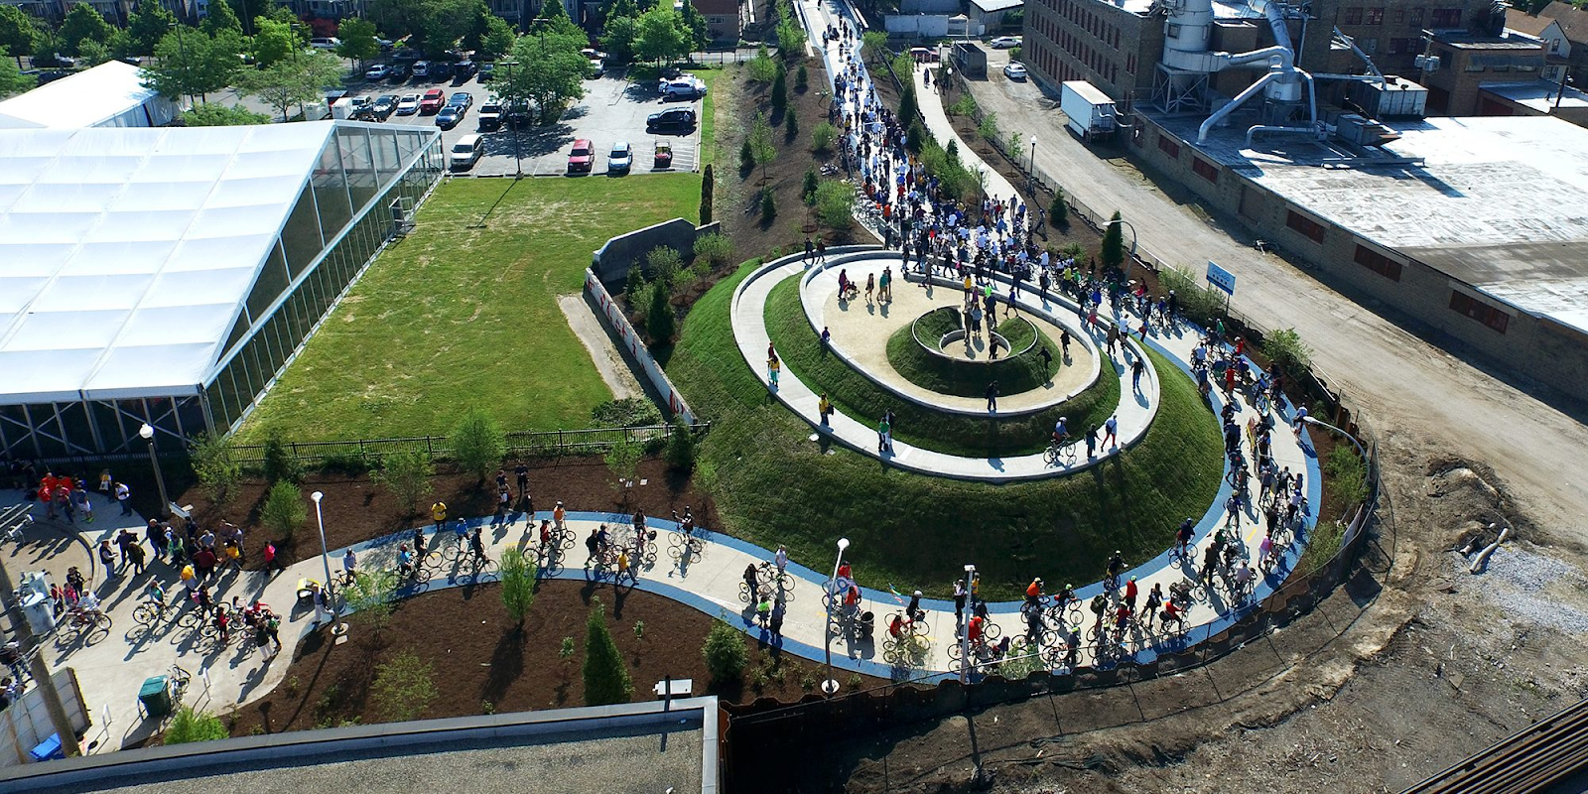
“
My tips for you ride a bike in Chicago
Route
606

Slide 23
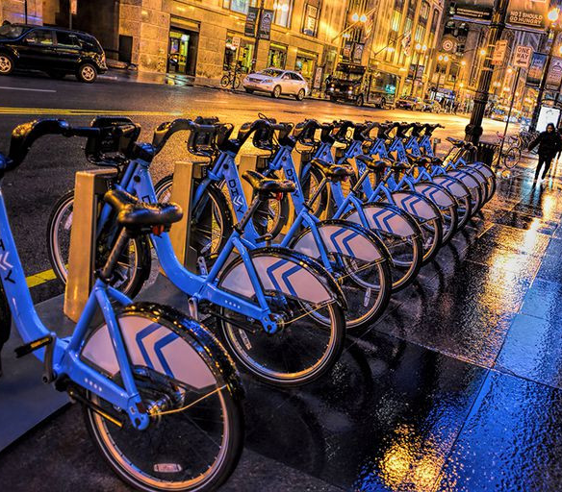
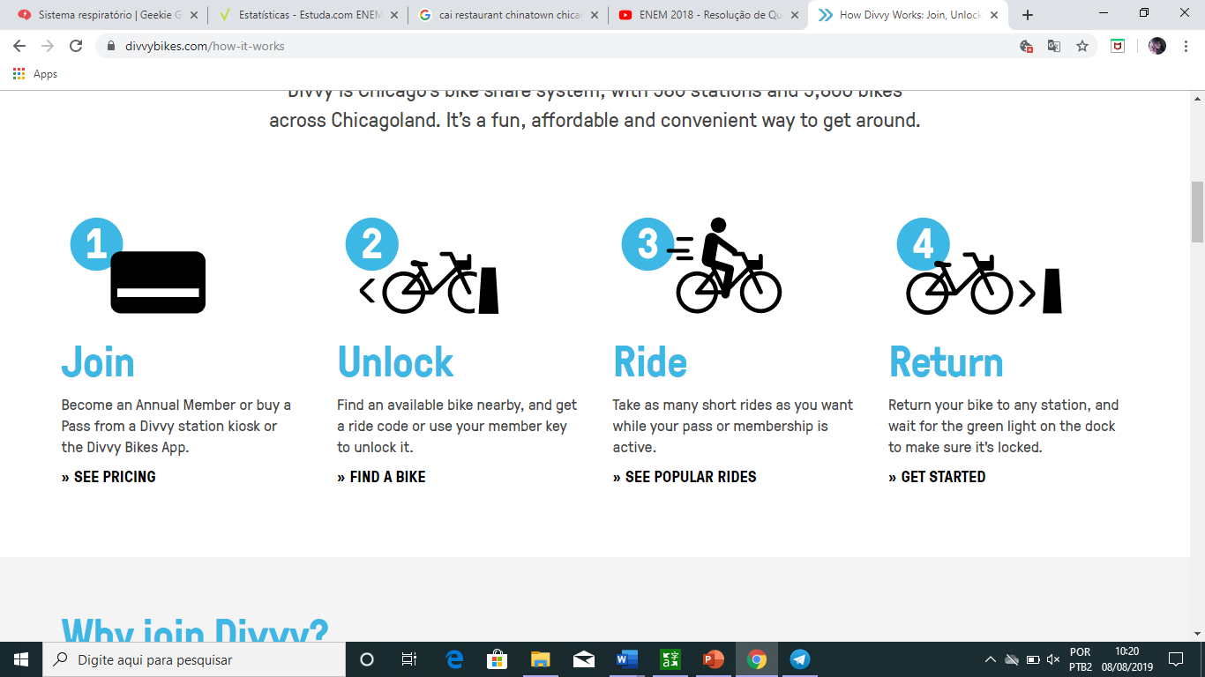

Divvy Bikes
Divvy station kiosk or the Divvy Bikes App.
Find an available bike nearby
Take as many short rides as you want while your pass or membership is active.
Return your bike to any station

Slide 24
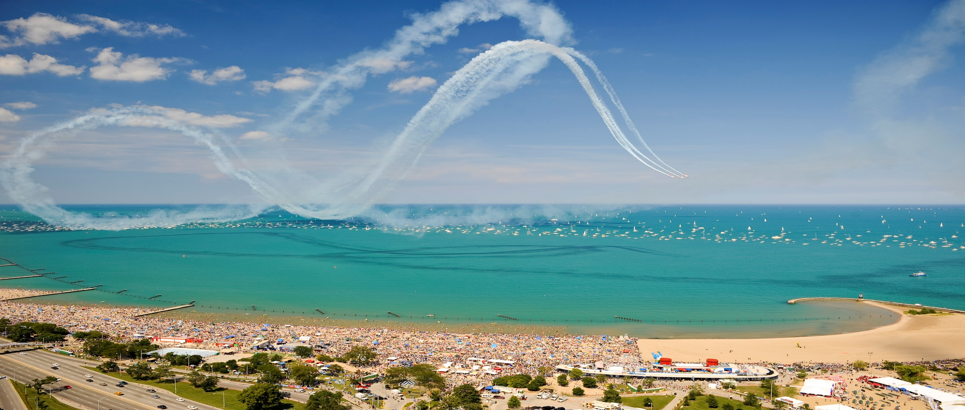
Air and Water Show
Lakefront North Avenue Beach Chicago, IL 60614
The Chicago Air & Water Show began in 1959 as a "Family Day"
Admission Free

Slide 25
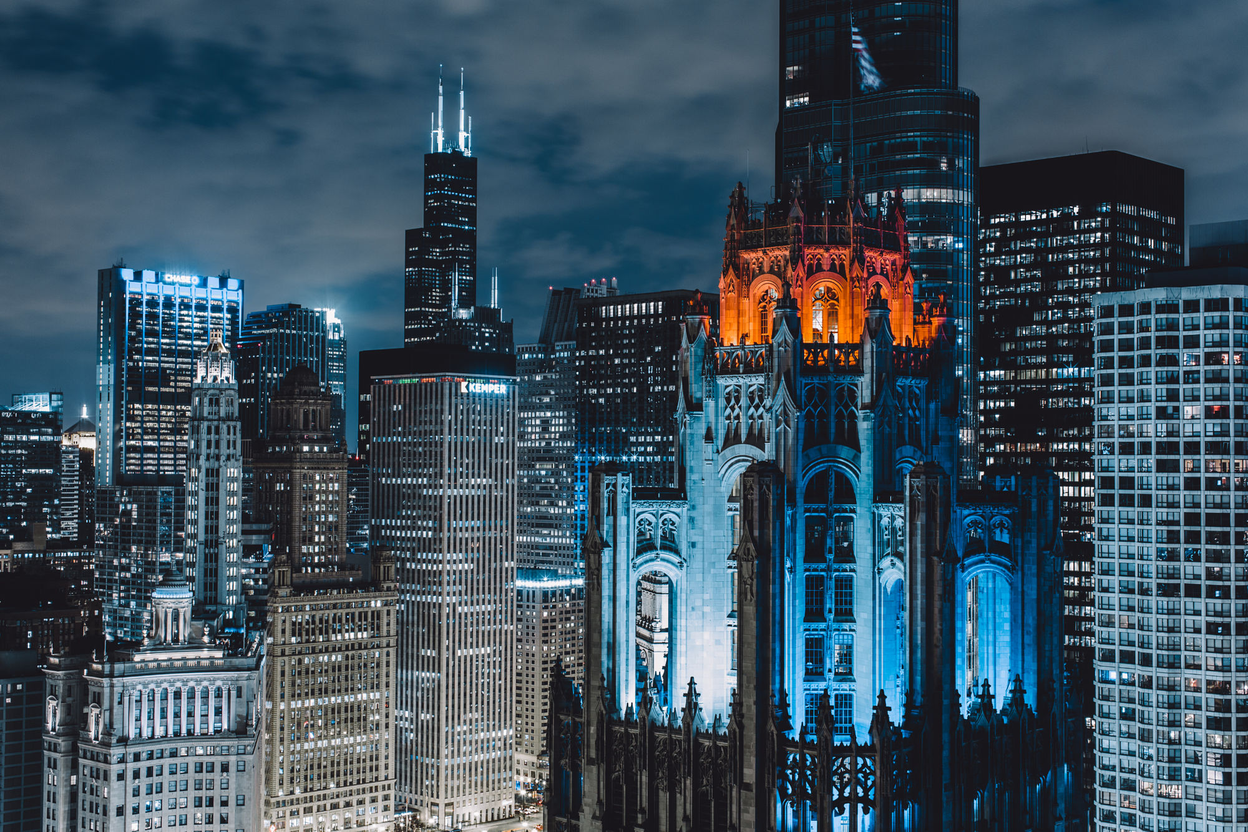
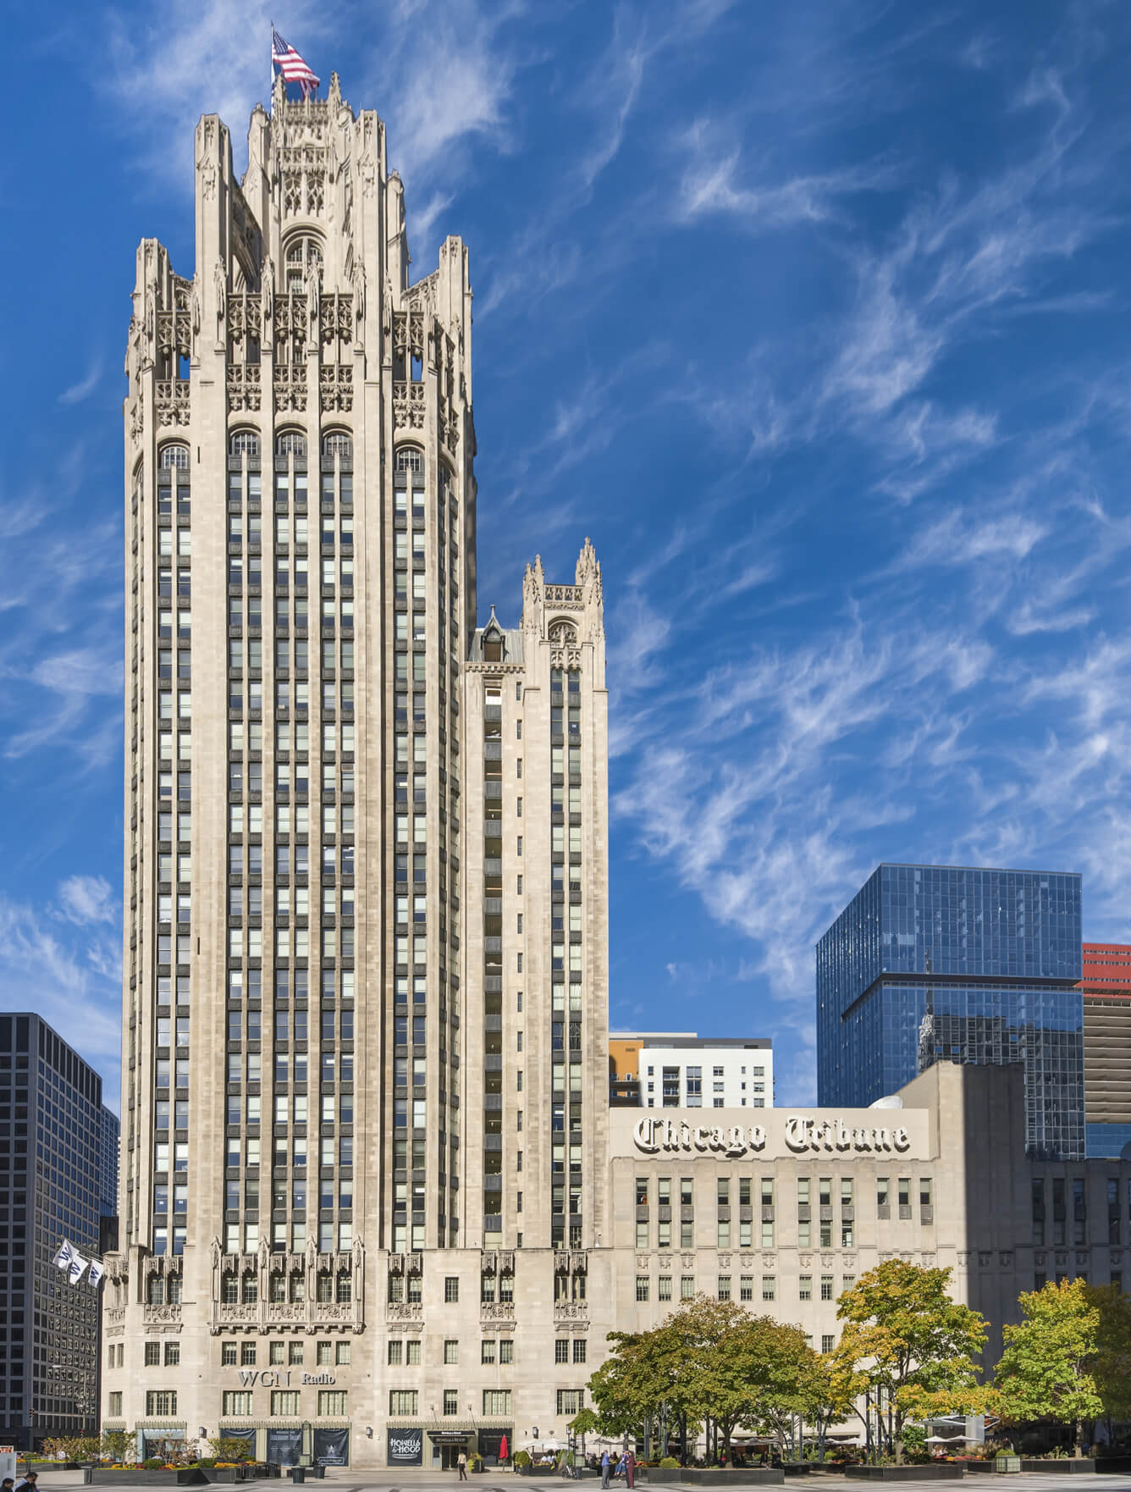
Nº 435
North Michigan Avenue
Chicago
Tribune Tower
Built between 1923 and 1925

Slide 26
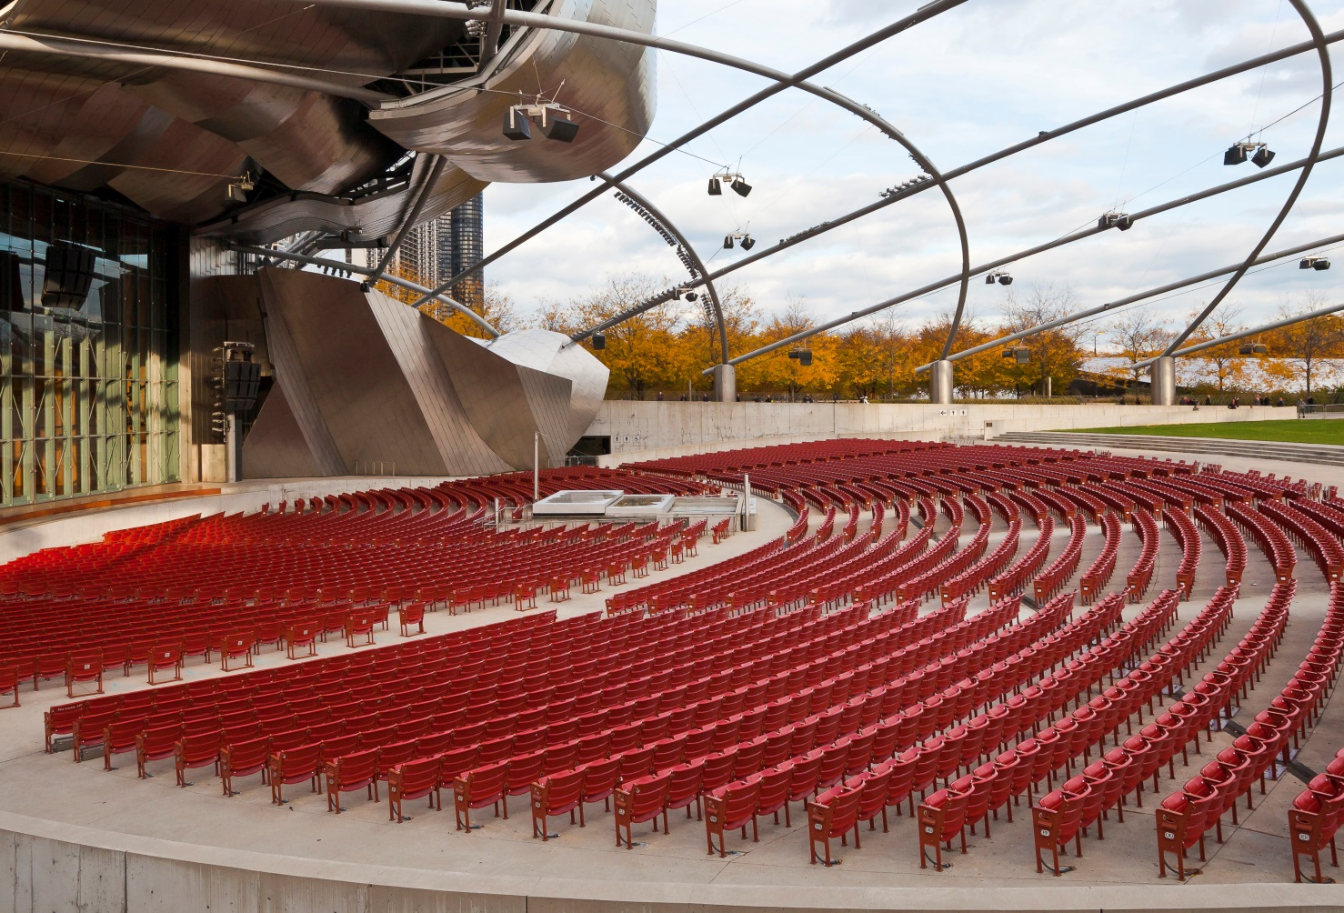
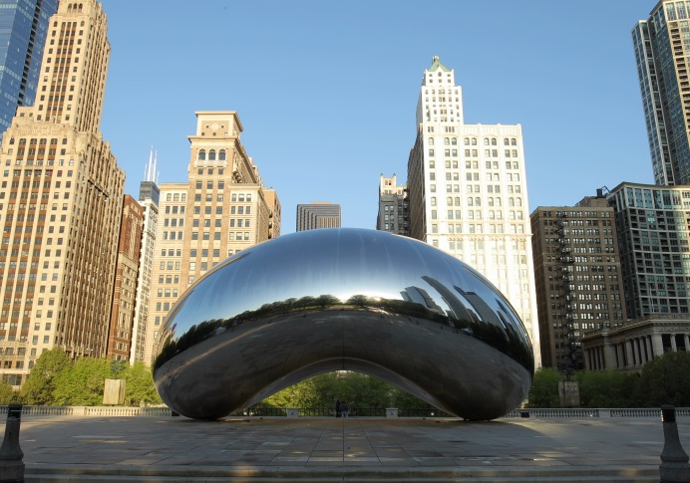
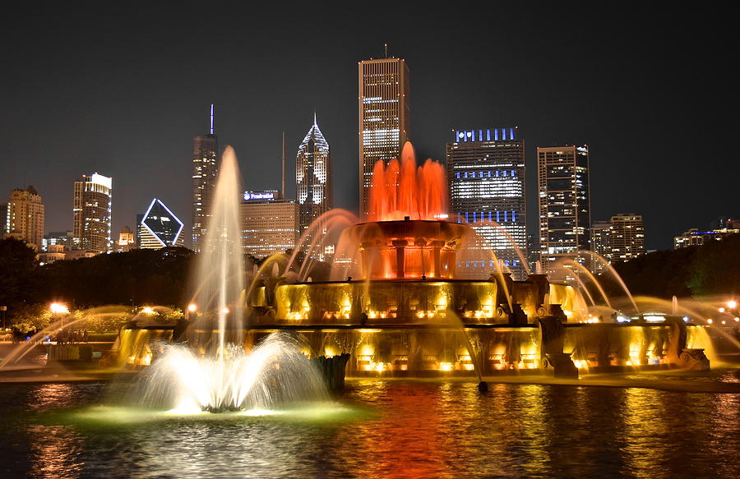
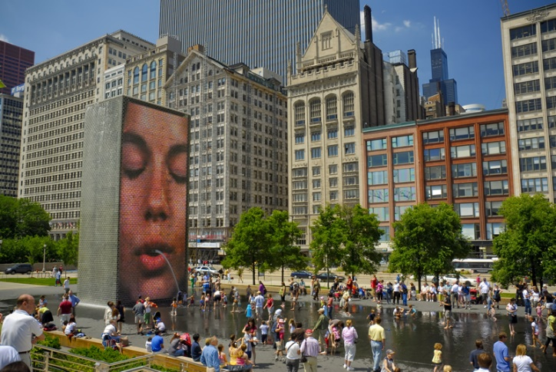
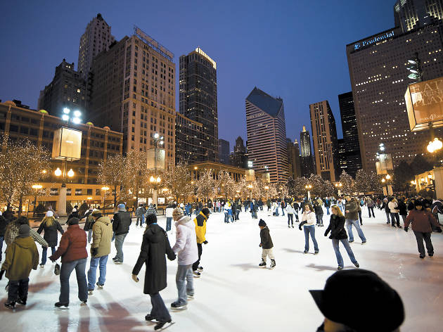
Grant Park
Millennium Park
Inside of the Grant Park has a other park called Millennium Park built 2000.

Slide 27
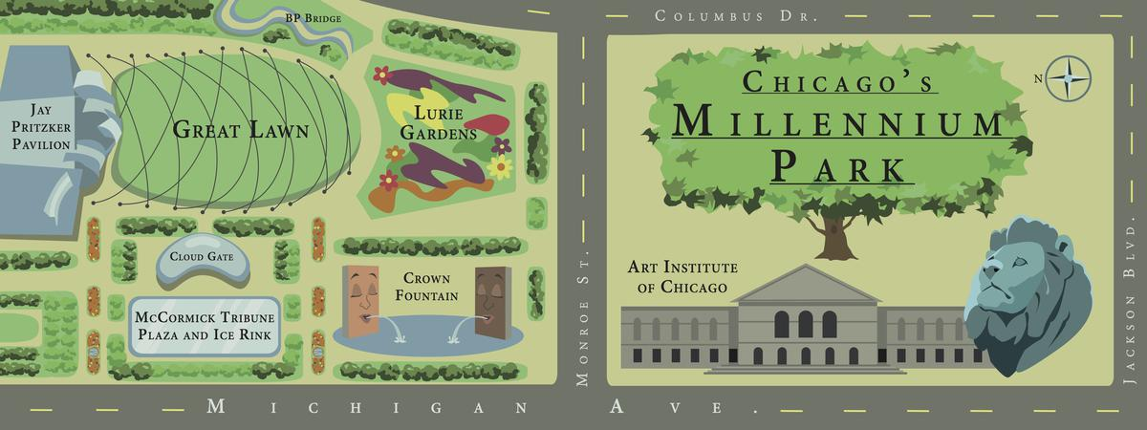

Slide 28
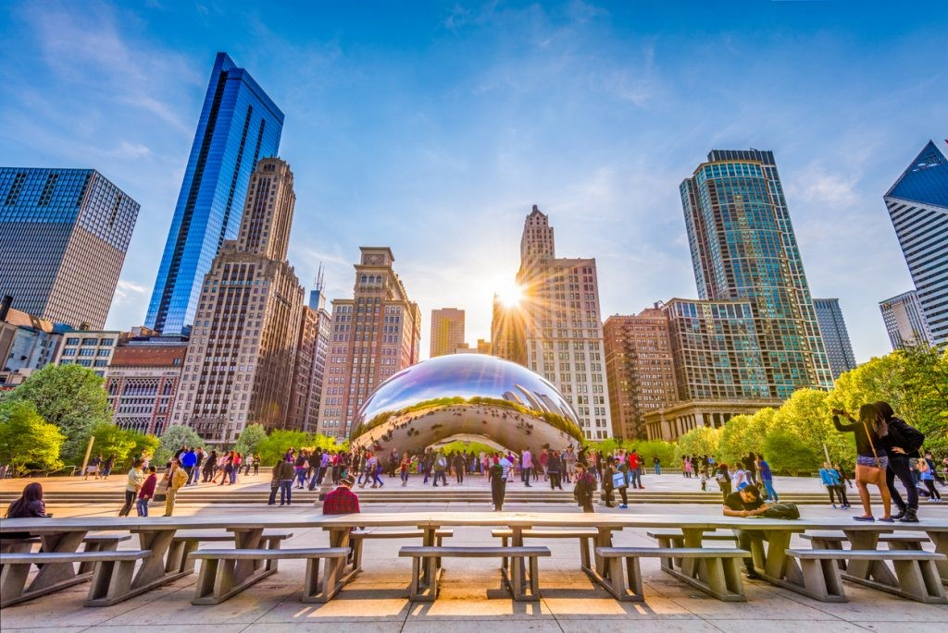
Cloud Gate is British artist Anish Kapoor's first public outdoor

Slide 29
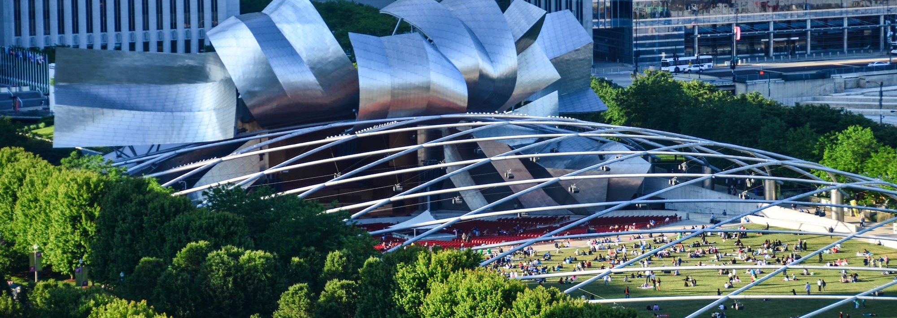
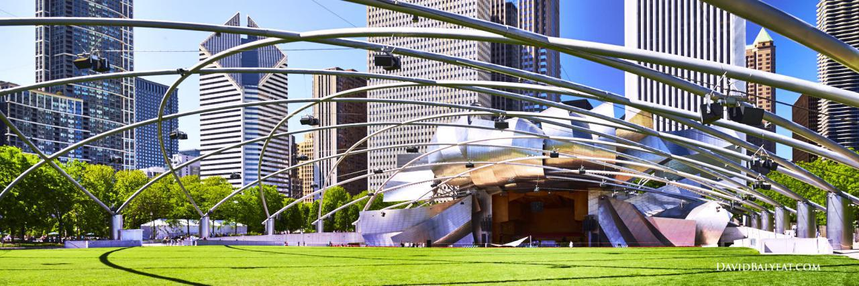
Jay Pritzker Pavilion
FRANK GEHRY
2004
WAS DESIGNED TO MIMIC THE ACOUSTICS OF AN INDOOR CONCERT HALL

Slide 30



Grant Park Orchestra
Lollapalooza
August 1 until 4
11AM – 10PM each day.
Gospel;
Mariachi and World Music Festivals;
Chicago Jazz Philharmonic;
Lyric Opera;
Grant Park Music Festival.

Slide 31



BLUES MUSIC
Live music in Rosa’s Lounge, Paradise of the Blues since 1984

Slide 32


HOUSE MUSIC
New style emerged in 1980
Gave rise to many music subgenres

Slide 33

Chicago also has a very expressive jazz scene
First Monday of September
JAZZ

Slide 34





McCormick Tribune Ice Rink
On Fridays, Saturdays and Sundays

Slide 35

Crown Fountain
Work interective
Jaume Plensa
led panels
Opened 2004

Slide 36


The Faces in the Fountain

Slide 37


The Art Institute of Chicago
is one of the world’s great galleries
contains more than 300,000 works of art.

Slide 38


*color range
(Gama de Cores)
Van Gogh self-portrait
Experience the incredible color range
Any of the principal artists are:
Edgar Degas;
Claude Monet;
Pablo Picasso.
Details of an Ansel Adams landscape photograph
*landscape
(Panorama)

Slide 39


Start in the Grant Park
Route 66

Slide 40



GRANT PARK
Buckingham Fountain
This fountain is a of the largest in the world
Colored lights

Slide 41







4,9 km²
LINCOLN PARK

Slide 42


The Navy Pier is available shows;
There is:
Cinema I-Max;
The Shakespeare Theater;
The circus;
The amusement park.
And are available during all year

Slide 43





.
Over the summer, the company tours a professional production of Shakespeare’s work, free for all.

Slide 44

Site: navypier.org

Slide 45




At Navy Pier

Slide 46



Chicago Theater
The first big cinema theather of the US
French Baroque style
Called "the Wonder Theatre of the World"

Slide 47






Ferris Burller's day off
Divergente
Movies
Curtindo a vida adoidado
transformers
Esqueceram de mim
Home Alone

Slide 48



*Strives (Esforça-se)
American Writers Museum
Strives to:
Educate the public about American writers – past and present

Slide 49




The building was built in 1893
Opened in 1933
one of the largest science museums in the world

Slide 50


German Sub
Tornado Simulator

Slide 51

Stuffed Pizza
Restaurant Giordano’s

Slide 52

Modern PowerPoint Presentation
Graphic Infographic Designed
Chicago Red Hot
Sausage;
Green Pepper (Sport Pepper);
Relish;
Celery;
Mustard.
Or
Chicago-style hot dog

Slide 53


Chinatown
Chinese New Year was comemorate in February 5 this year.
All years change the day this commemorate that is between the days of January 21 and February 20

Slide 54





Slide 55







Sports
Football is the most popular american sport
Basktball is the second
Golf is the third

Slide 56




Who is this famous golfist?

Slide 57



Football in Chicago
American football

Slide 58


Basktball is the second

Slide 59


Thanks!

